Slide 1

Shadow Neural Radiance Fields for 3D Earth Observation
Dawa Derksen - Postdoctoral Research Fellow
Advanced Concepts Team – ESTEC Netherlands
dawa.derksen@esa.int
Supervision : Dario Izzo
ESA UNCLASSIFIED - For Official Use
ESA | January 2021 | Slide 1

Slide 2
Presentation outline
Introduction to Photogrammetry for Earth Observation
Basics of Neural Volume Rendering
Shadow Neural Radiance Field
Preliminary results
Conclusion and further applications

Slide 3
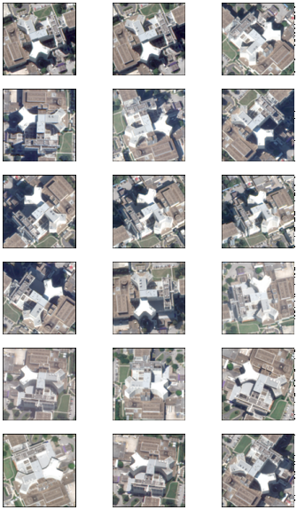
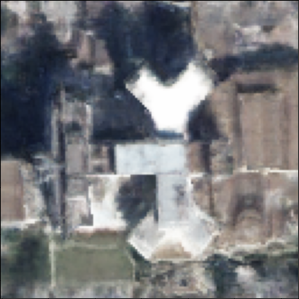
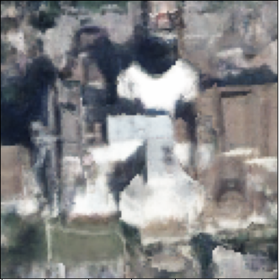
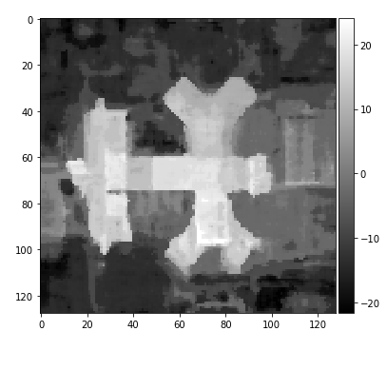
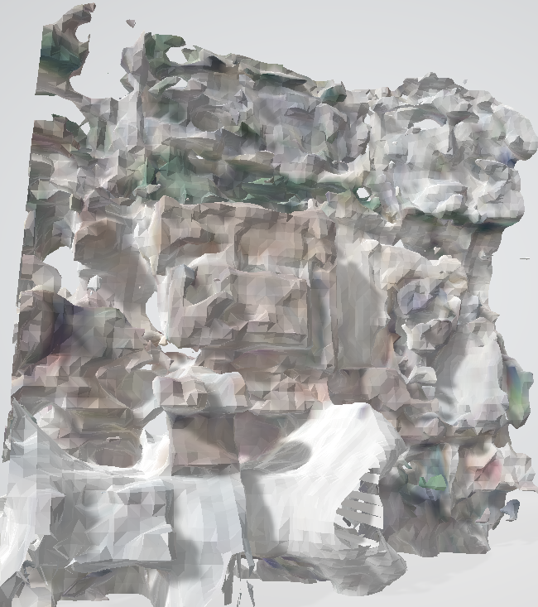
Photogrammetry for Earth Observation
Multi-view satellite images
New views
Volumetric
representation
Depth (topography)
Polygonal 3d surface model
Source : WorldView-3 (0.3m RGB)

Slide 4
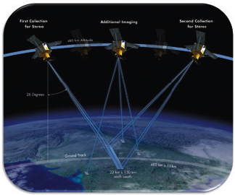
Photogrammetry for EO – Scope and applications
Use of optical images only
No active sensor e.g. radar, lidar
Low energy consumption
Off-nadir images exhibit vertical structure
Tomography
Vegetation height estimation (biomass)
Land cover classification
Change detection
Building destruction, deforestation
Other domains
Autonomous landing, deep space exploration
off-nadir

Slide 5
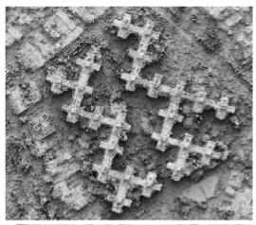
Prior work (EO): Semi-Global Matching
Mutual information based pixel matching [Hirschmüller 2008]
Requires similar capture conditions [Krauß 2018]
Efforts to include tolerance to non-correlation [Rupnik 2018, 2019]
Sources of non-correlation : time-dependent phenomena
Shadows
Specularity – matte/glossy
Transient objects – cars, airplanes
Seasonal variation – leaf growth/loss
Weather effects – snow
Land cover change – deforestation, construction
Light source (sun)
Scene itself

Slide 6
Prior work (EO): Semi-Global Matching
Limitations of SGM
Structures with overhang (trees, monuments)
Semi-opaque/transparent surfaces (glass)
Pixel matching sensitive to non-correlation
Can we benefit from non-correlation ?
Position/shape of shadows varies according to scene geometry
Slow temporal variations can indicate the presence of vegetation
Cars are mainly in parking lots or on roads (flat surfaces)
“New” paradigm in 3D graphics - Representation learning
Exploit the capacity of ML algorithms to memorize data
Create a learning scheme with physics-inspired rules

Slide 7
Presentation outline
Introduction to photogrammetry for Earth Observation
Basics of Neural Volume Rendering
Neural Radiance Field (NeRF)
Sensor model and view synthesis
Shadow Neural Radiance Field
Preliminary results
Conclusion and further applications

Slide 8
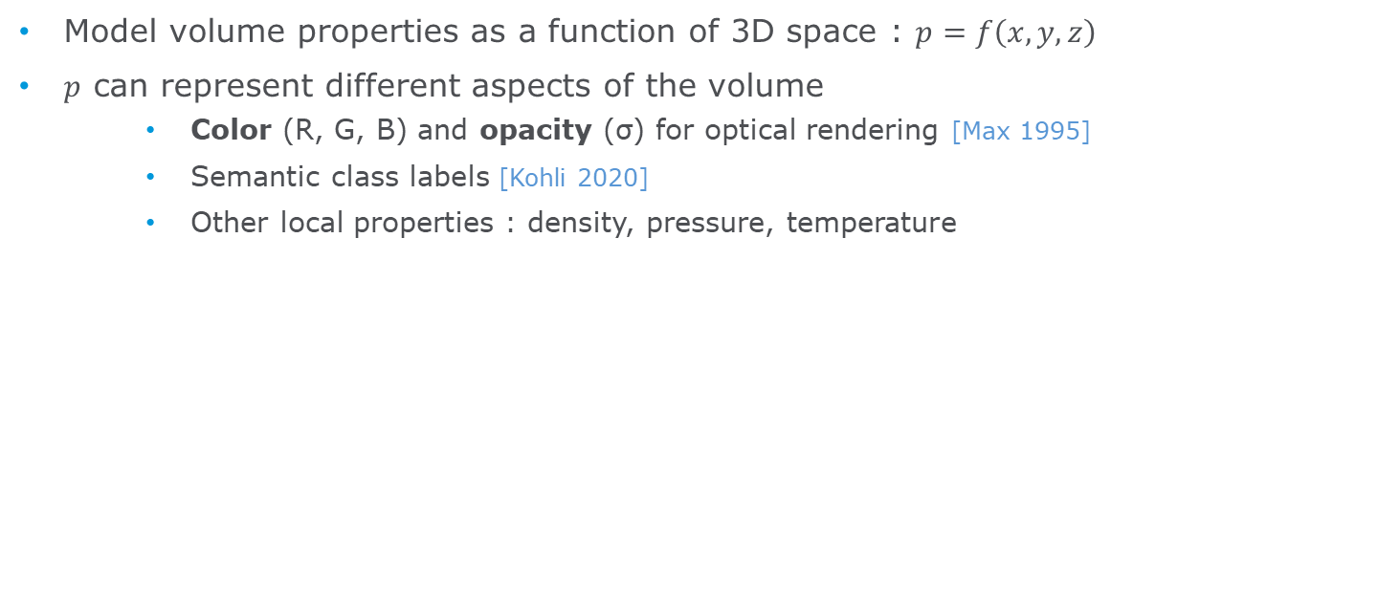


Volumetric representations
Model volume properties as a function of 3D space : $p=f\left(x,y,z\right)$
$p$ can represent different aspects of the volume
Color (R, G, B) and opacity (σ) for optical rendering [Max 1995]
Semantic class labels [Kohli 2020]
Other local properties : density, pressure, temperature
R
x
$$f$$
G
y
$$f$$
B
z
σ
Volumetric representation for optical rendering

Slide 9
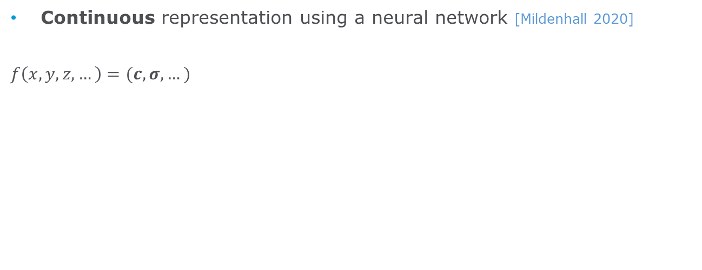

Neural Radiance Field (NeRF)
Continuous representation using a neural network [Mildenhall 2020]
$$f\left(x,y,z,…\right)=(c, σ,…)$$
Compact compared to voxel grid [Lombardi 2019]
Resolution depends on network size
Trivial to add new dimensions (inputs)
Ex : Addition of viewing angles for specular effects
Trivial to add new volume properties (outputs)
Ex : IR bands, albedo, class label, etc.
R
x
G
y
$$\hat{f}$$
B
z
σ
[NeRF: Representing Scenes as Neural Radiance Fields for View Synthesis, Mildenhall et al. 2020]

Slide 10
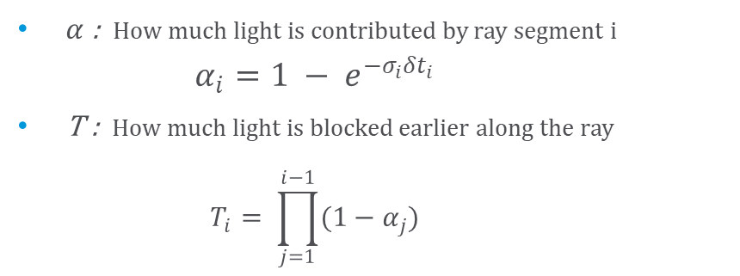
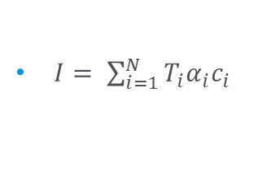
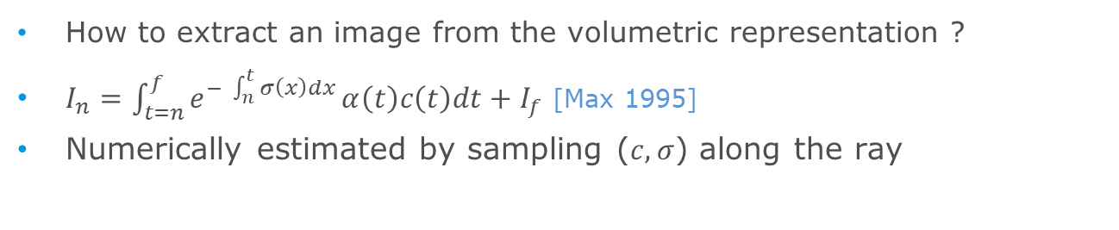
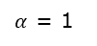
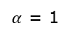
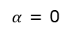
Emissive rendering equation
How to extract an image from the volumetric representation ?
$I_{n}=\int_{t=n}^{f}{e^{− \int_{n}^{t}{σ\left(x\right)dx}}}α\left(t\right)c\left(t\right)dt+I_{f}$ [Max 1995]
Numerically estimated by sampling ($c, σ$) along the ray
colors
$I= \sum_{i=1}^{N}{T_{i}α_{i}c_{i}}$
Fully differentiable!
$α$ : How much light is contributed by ray segment $i$
$$α_{i}=1 − e^{−σ_{i}{δt}_{i}}$$
T : How much light is blocked earlier along the ray
$$T_{i}= \prod_{j=1}^{i−1}{(1−α_{j})}$$
$α$ = 0
T = 1
$α$ = 1
T = 1
$α$ = 1
T = 0
$α$ = 0
T = 0

Slide 11
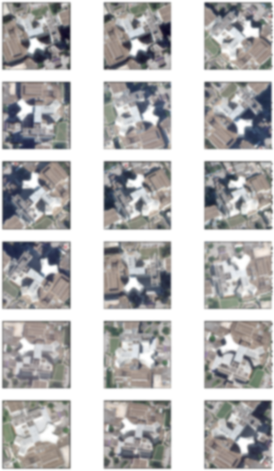

NeRF Training
Virtual
sensor
Rendered image
Collection of images + viewing angles
Multi-view
Consistency
Volumetric
representation
(NeRF)
$$∆ =loss$$
Training image
r
x
g
y
$$\hat{f}$$
b
z
σ

Slide 12
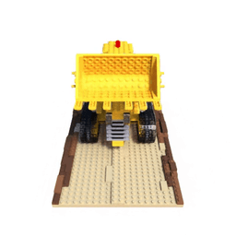
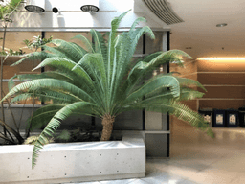
Neural Radiance Field (NeRF) – view synthesis
About 20 training images – specular effects successfully modeled

Slide 13
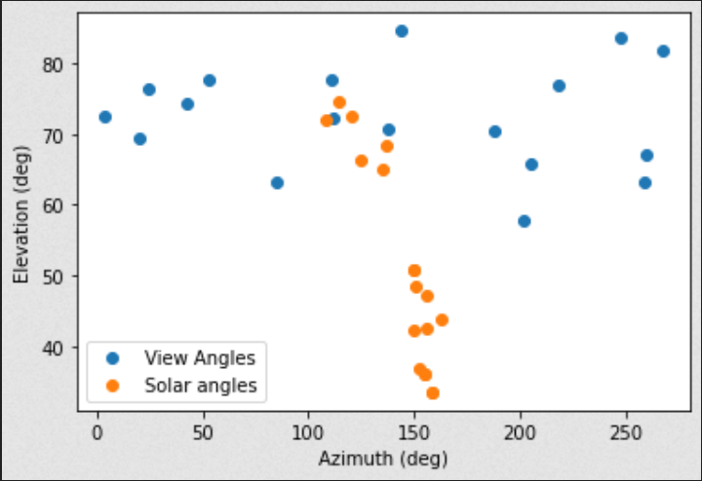
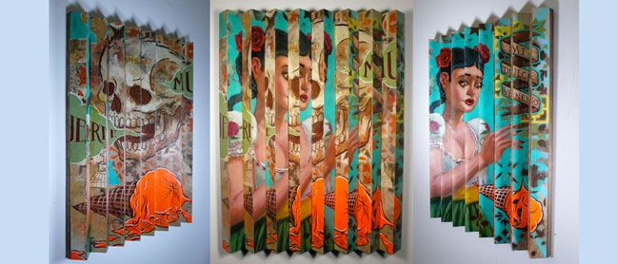
Limitations of “off the shelf” NeRF
Designed for images with constant lighting conditions
Unfit for off-nadir satellite imagery
Solar direction varies across data set
Other kinds of space-based imagery
Comets, moons, asteroids, other satellites, etc.
Direct application leads to inaccuracies in shaded areas
Floating particles
Lenticular painting effects
Art by Randy Noborikawa

Slide 14

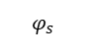
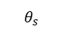
First research objectives
Propose and evaluate a shadow-aware NeRF model
Proper modeling of shaded areas (limited depth inaccuracies)
Detect shadows
Synthesize accurate views at unseen solar angles (interpolation, extrapolation)
Shadow removal
x
R
y
G
R
x
G
B
z
$$\hat{f}$$
y
$$\hat{f}$$
B
σ
z
σ
$$θ_{s}$$
$$φ_{s}$$
s
Standard NeRF
Shadow NeRF (SNeRF)

Slide 15
Presentation outline
Introduction to photogrammetry for Earth Observation
Basics of Neural Volume Rendering
Shadow Neural Radiance Field
Directional/diffuse light source modeling
Solar Correction rays
Preliminary results
Conclusion and further applications

Slide 16
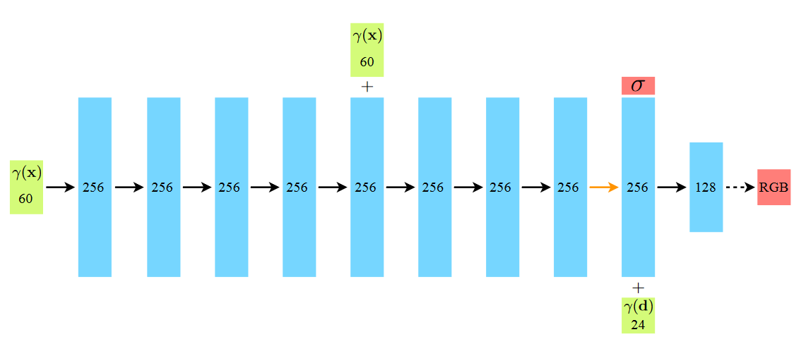
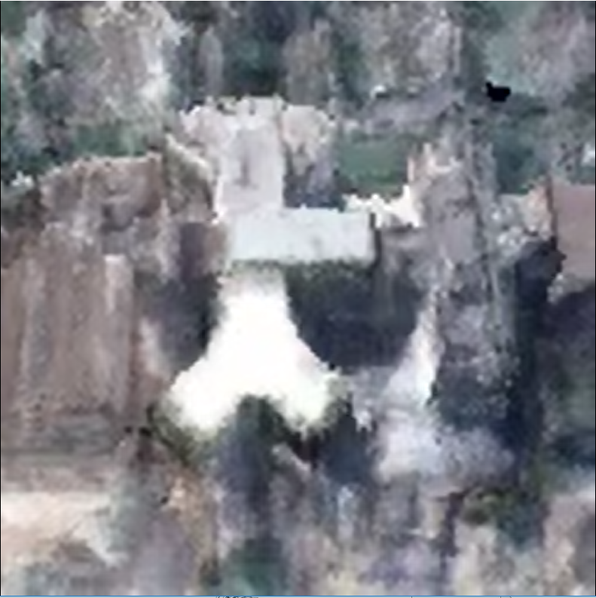
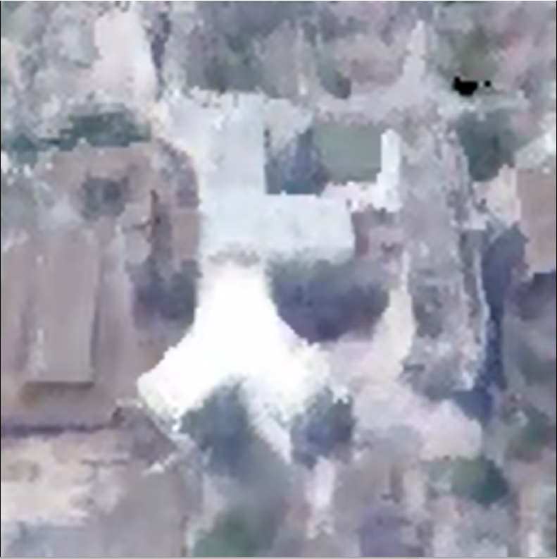
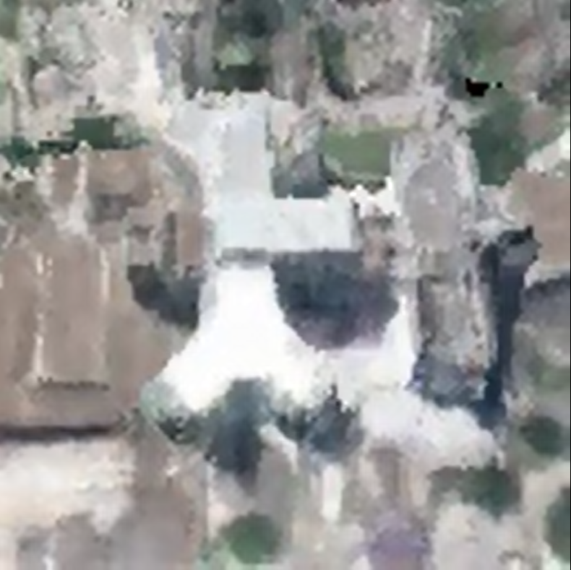
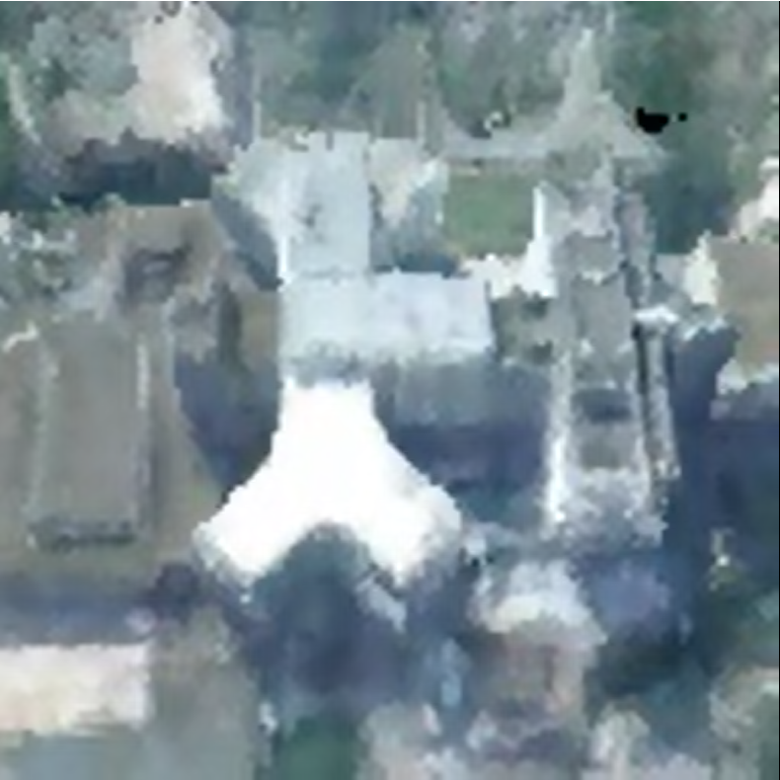
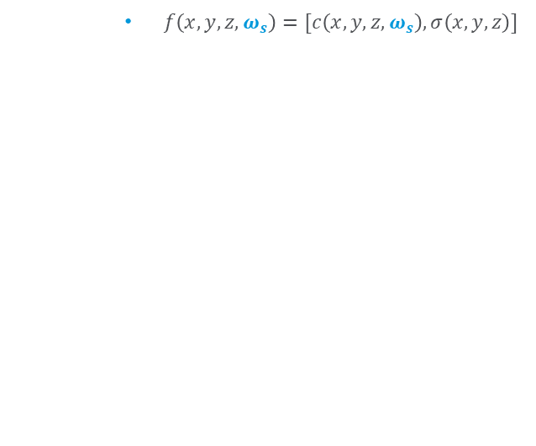
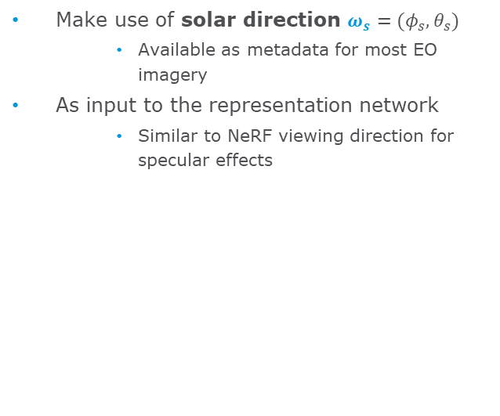
Naïve shadow model
Make use of solar direction $ω_{s}=(φ_{s}, θ_{s})$
Available as metadata for most EO imagery
As input to the representation network
Similar to NeRF viewing direction for specular effects
$f\left(x,y,z,ω_{s}\right)=[c\left(x,y,z,ω_{s}\right), σ\left(x,y,z\right)]$
Result : Poor interpolation due to under-regularized color values at unseen solar directions
No explicit disentanglement of illumination vs. color
Solar direction

Slide 17
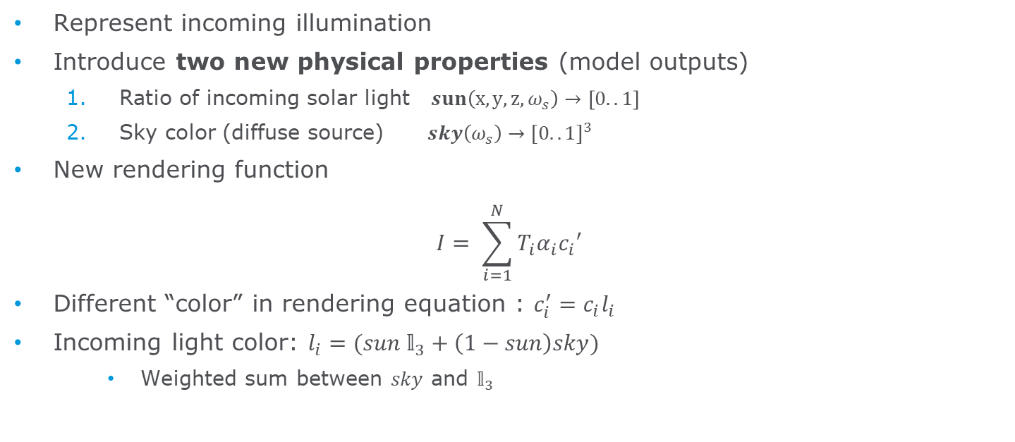
Shadow Neural Radiance Field
Represent incoming illumination
Introduce two new physical properties (model outputs)
Ratio of incoming solar light $sun\left(x,y,z,ω_{s}\right)→\left[0..1\right]$
Sky color (diffuse source) $sky\left(ω_{s}\right)→[0..1]^{3}$
New rendering function
$$I= \sum_{i=1}^{N}{T_{i}α_{i}c_{i}′}$$
Different “color” in rendering equation : $c_{i}^{′}=c_{i}l_{i}$
Incoming light color: $l_{i}=(sun{ 𝕝}_{3}+\left(1−sun\right)sky)$
Weighted sum between $sky$ and $𝕝_{3}$
sun = 1
sun = 0
sun = 0
sun = 0

Slide 18
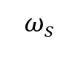
SNeRF network architecture
Few extra parameters needed
$$ω_{s}$$
SUN (1D)
SKY (3D)

Slide 19
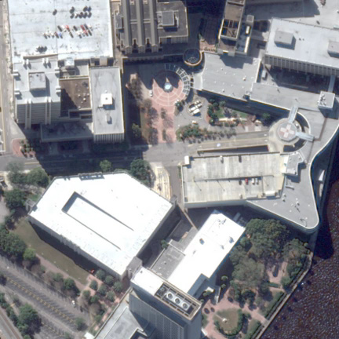
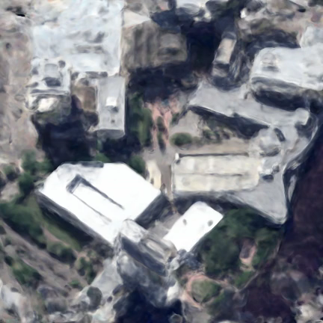
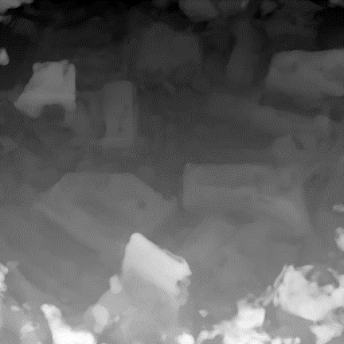
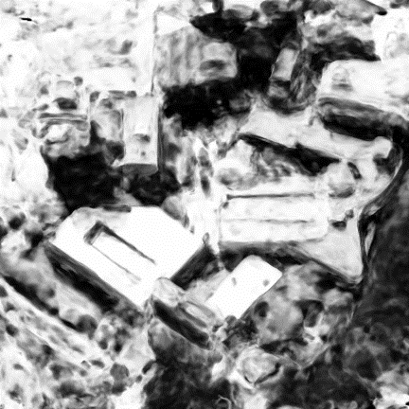
First result and limitation
Sun function entirely learned from non-correlation in the data set
Areas that are always in the shadow have a dark RGB color and are modeled as always in the sun
World-view 3 data only has morning pictures : certain building facades are always in the shadow
Could be improved using the learned scene geometry
Training images
Synthetic images
3d surface
Sun function at surface

Slide 20
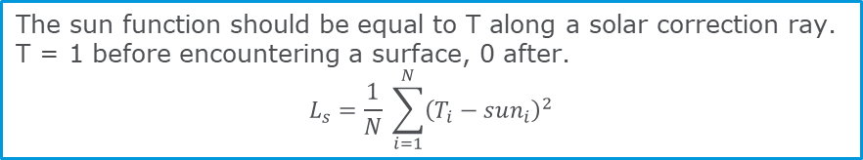
Solar correction rays
Make the network learn the shadows based on the scene geometry
Linear increase in memory and time (2N)
The sun function should be equal to T along a solar correction ray.
T = 1 before encountering a surface, 0 after.
$$L_{s}=\frac{1}{N} \sum_{i=1}^{N}{{\left(T_{i}−sun_{i}\right)}^{2}}$$

Slide 21
Solar correction rays
Which solar angles to consider for ray generation ?
Training image angles
Achieve high fidelity on training images
Any other angles !
Sampled to fill in the gaps between training angles
Sampled regularly on the entire upper hemisphere

Slide 22
Overview of changes to NeRF volume rendering
2 new dimensions : solar direction as network input
Requires knowledge of incoming light conditions
2 new physical properties : sun and sky as network outputs
Small extra cost in memory (larger network)
Shadow-aware rendering
Outgoing light depends on color of incoming light (sun and sky)
No extra cost at inference time
Solar correction rays
Learn sun based on scene geometry
Linear increase in memory and time (2N) during training

Slide 23
Presentation outline
Introduction to photogrammetry for Earth Observation
Basics of Neural Volume Rendering
Shadow Neural Radiance Field
Preliminary results
Solar correction rays
Different areas
Conclusion and further applications

Slide 24
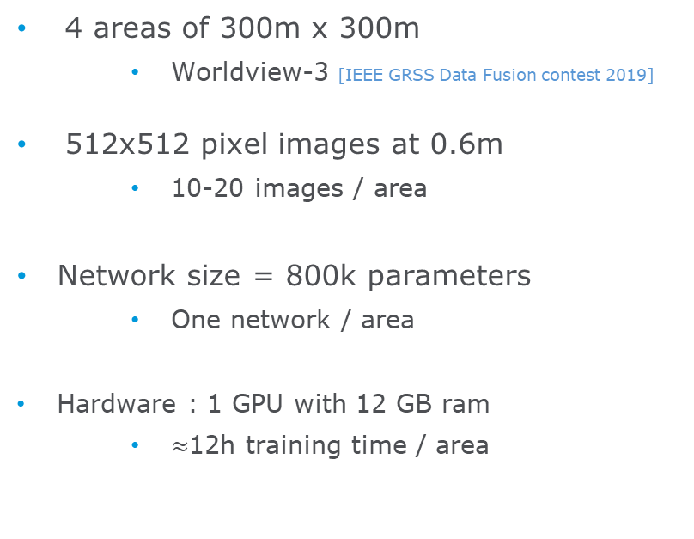
Experimental setup
4 areas of 300m x 300m
Worldview-3 [IEEE GRSS Data Fusion contest 2019]
512x512 pixel images at 0.6m
10-20 images / area
Network size = 800k parameters
One network / area
Hardware : 1 GPU with 12 GB ram
$≈$12h training time / area
Training images - area 1
http://www.grss-ieee.org/community/technical-committees/data-fusion/2019-ieee-grss-data-fusion-contest/

Slide 25
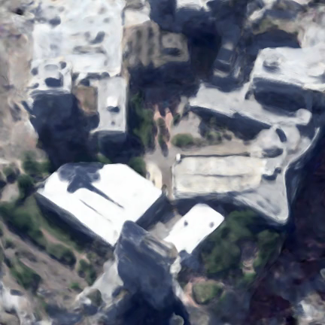
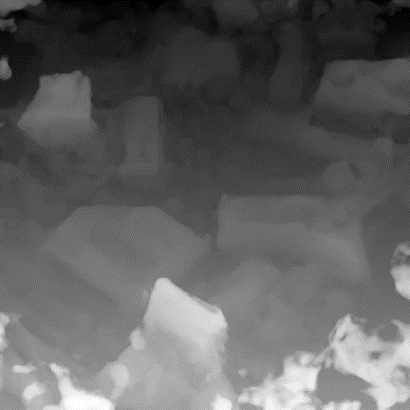
Depth estimation
Synthetic images
Depth estimation

Slide 26
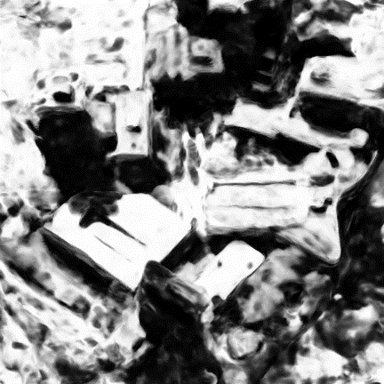
Rendered sun function - shadow detection
Synthetic images
Sun function

Slide 27
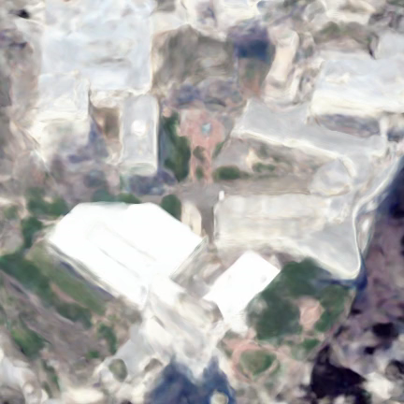
Shadow-free rendering
Synthetic images
Shadow-free rendering

Slide 28
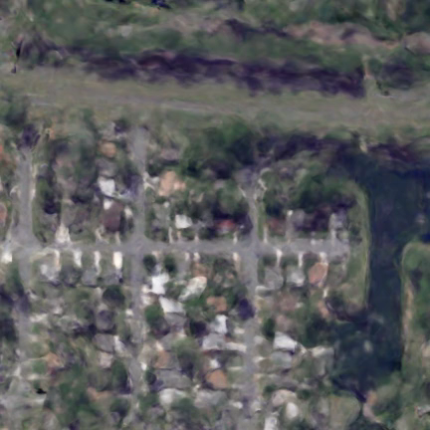
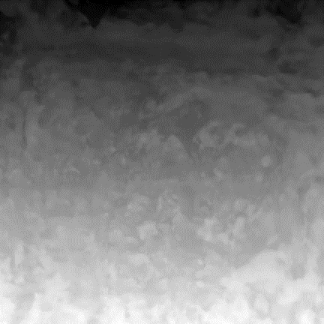
Other areas – diffuse urban cover

Slide 29
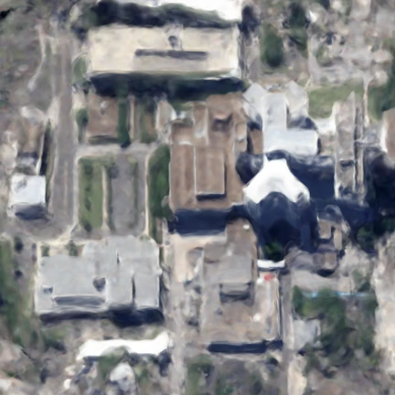
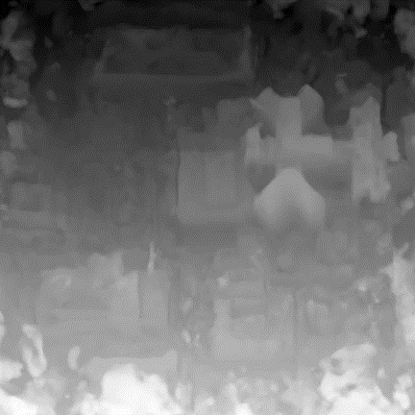
Other areas – Industrial / commercial area

Slide 30
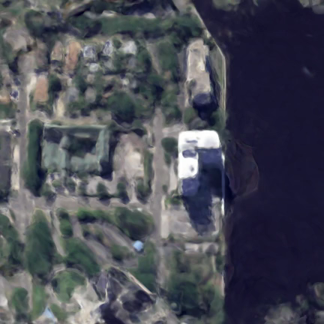
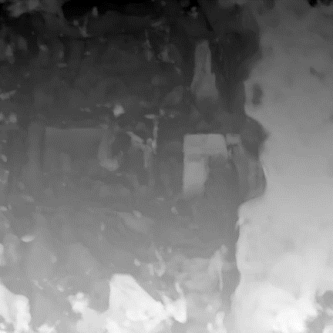
Other areas – Coastal diffuse urban

Slide 31
Quantitative evaluation
Average altitude estimation error (RMSE) = 3-5 m (w.r.t airborne LiDAR)
Average train image PSNR = 25-30
Average test image PSNR = 20-25
More complete evaluation (60 areas) in upcoming publication
 | NeRF | SNeRF + SC
Test PSNR | 20.27 | 23.56
Test SSIM | 0.7589 | 0.897
Av. Alt. err (m) | 6.971 | 4.361

Slide 32
Presentation outline
Basics of Neural Volume Rendering
Shadow Neural Radiance Field
Preliminary results
Conclusion and further applications
Overview
Current limitations
Outlook

Slide 33
Overview of advantages
Advantages of SNeRF compared to SGM
No need for pairs/triplets in stereo configuration
Any number of images
Potentially different resolutions and spectral bands
Shadows are a part of the model
Act as a source of information rather than a perturbation
Can be detected and even removed
If successful, could alleviate constraints for off-nadir EO satellites
No more need for stereo configuration with similar capture conditions
More diverse viewing angles and shadow positions are better

Slide 34
Current limitations
Need to train one model for each area
Not yet scalable to very large areas
Possible generalization using hypernetworks [Stitzmann 2020] or network conditioning [Trevithick 2020], demonstrated on computer vision tasks
Learn from commonalities between scenes
Poor performance on flat, texture-free surfaces
Water, buildings
Unable to learn if there are no visual cues
Perturbed by other time-dependent effects
NeRF in the Wild [Martin-Brualla 2020]
Conditional representation can distinguish static from time-dependent elements

Slide 35
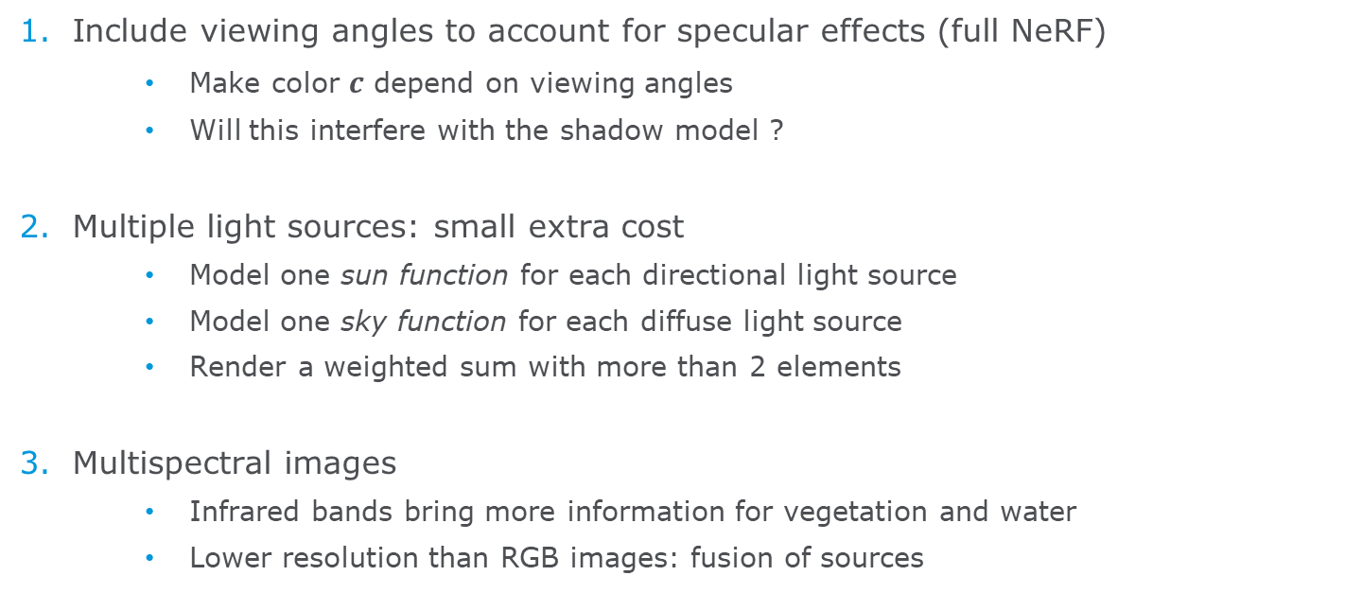
Possible extensions
Include viewing angles to account for specular effects (full NeRF)
Make color $c$ depend on viewing angles
Will this interfere with the shadow model ?
Multiple light sources: small extra cost
Model one sun function for each directional light source
Model one sky function for each diffuse light source
Render a weighted sum with more than 2 elements
Multispectral images
Infrared bands bring more information for vegetation and water
Lower resolution than RGB images: fusion of sources

Slide 36
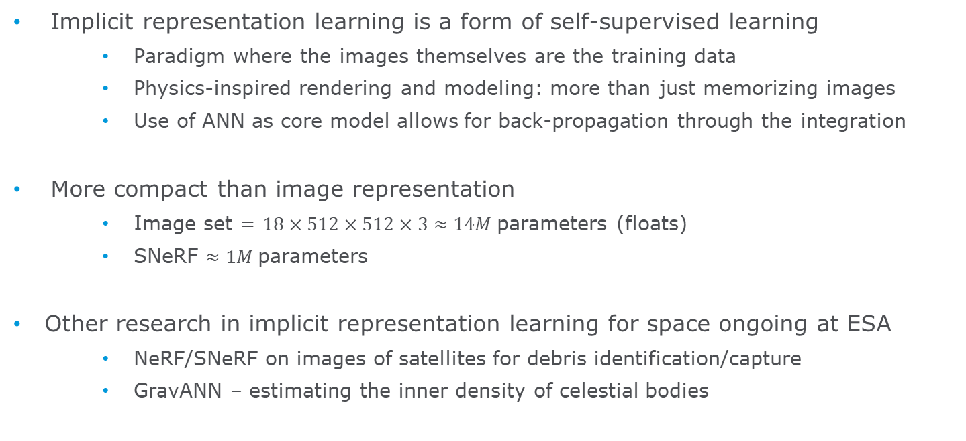
Outlook
Implicit representation learning is a form of self-supervised learning
Paradigm where the images themselves are the training data
Physics-inspired rendering and modeling: more than just memorizing images
Use of ANN as core model allows for back-propagation through the integration
More compact than image representation
Image set = $18×512×512×3≈14M$parameters (floats)
SNeRF $≈1M$parameters
Other research in implicit representation learning for space ongoing at ESA
NeRF/SNeRF on images of satellites for debris identification/capture
GravANN – estimating the inner density of celestial bodies

Slide 37
Bibliography
[Hirschmüller 2008] Stereo Processing by Semi-global Matching and Mutual Information - International Symposium on Visual Computing, 2008
[Rupnik 2018] 3D reconstruction from multi-view VHR satellite images in MicMac - ISPRS Journal of Photogrammetry and Remote Sensing, 139, 201-211.
[Krauß 2018] Cross-track satellite stereo for 3D modelling of urban areas - European Journal of Remote Sensing (2018)
[Rupnik 2019] More Surface Detail with One-Two Pixel Matching - Conférence Française de Photogrammétrie et de Télédétection 2018.
[Max 1995] Optical models for direct volume rendering - IEEE Transactions on Visualization and Computer Graphics 1.2 (1995): 99-108.
[Kohli 2020] Inferring Semantic Information with 3D Neural Scene Representations. arXiv preprint arXiv:2003.12673 (2020).
[Lombardi 2019] Neural Volumes: Learning Dynamic Renderable Volumes from Images. arXiv preprint arXiv:1906.07751 (2019).
[Mildenhall 2020] NeRF : Representing scenes as Neural Radiance Fields for view synthesis. arXiv preprint arXiv:2003.08934 (2020).
[Stitzmann 2020] Implicit Neural Representations with Periodic Activation Functions. Advances in Neural Information Processing Systems 33 (2020).
[Trevithick 2020] GRF: Learning a General Radiance Field for 3D Scene Representation and Rendering. arXiv preprint arXiv:2010.04595, (2020)
[Martin-Brualla 2020] NeRF in the Wild: Neural Radiance Fields for Unconstrained Photo Collections. arXiv preprint arXiv:2008.02268 (2020).

Slide 38
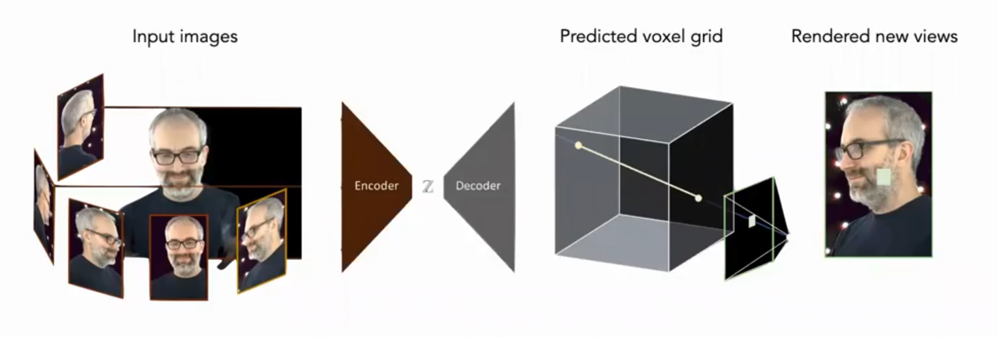
Prior work (vision) : discrete representations
Physical properties are contained in each voxel
Ex : Color, opacity
Neural Volumes [Lombardi 2019]
A CNN is trained to generate a voxel representation given a set of images
Outputs (voxel grids) require high storage capacity
High redundancy in discrete representation

